Slide 1
Virtual 3D House
Presented by Green Team
Notes:
TITLE

Slide 2
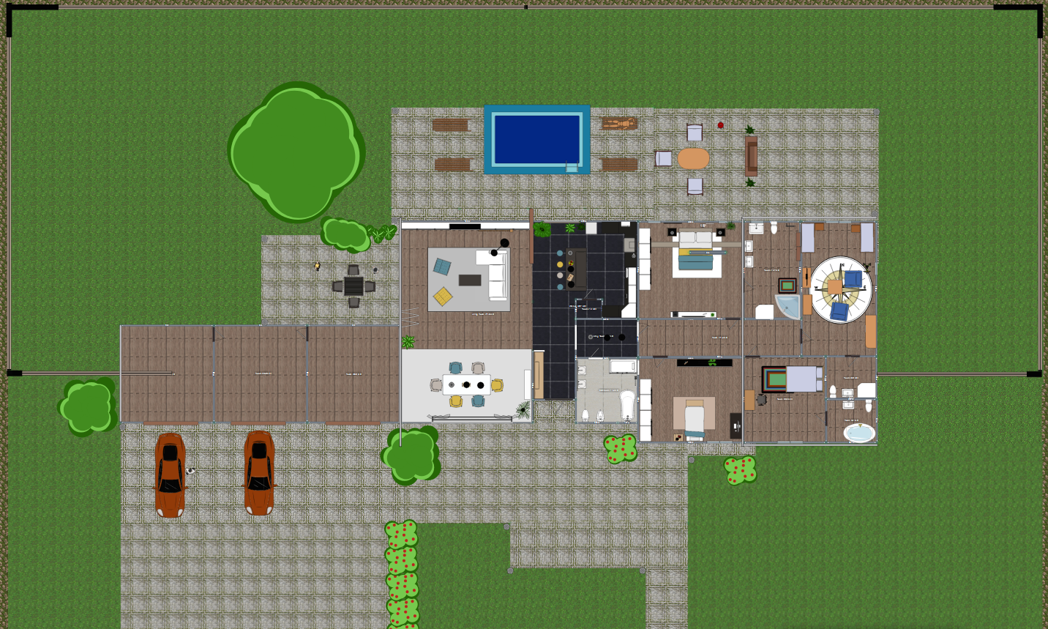
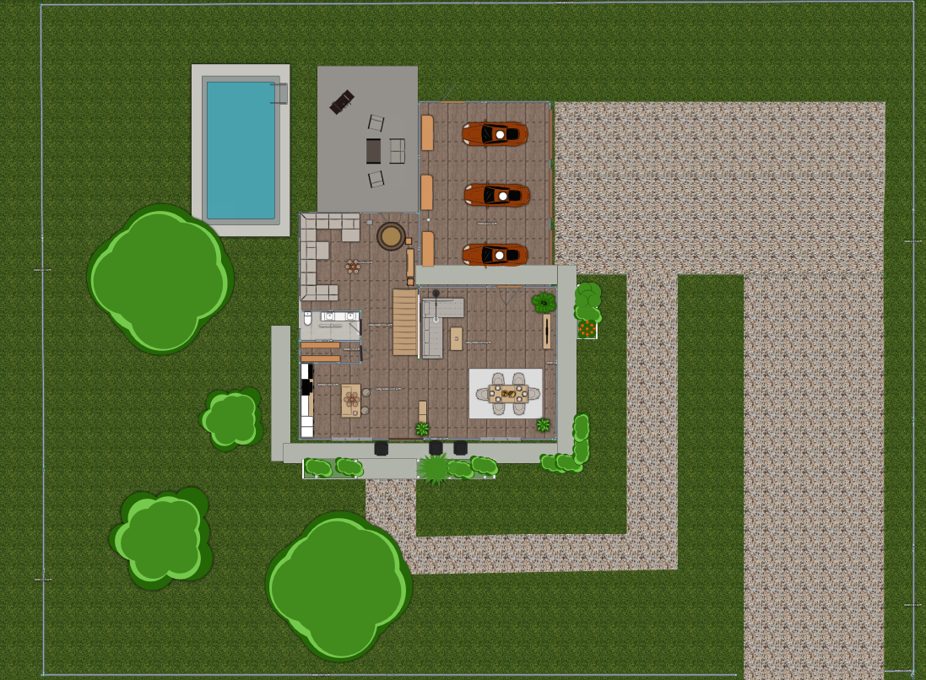
Long long time ago there existed a team who had no construction knowledge and project managing experience...
Then one day a SME, Subject Matter Expert, came and requested the team to develop a virtual house and present their journey to other SMEs.
This is the story of Green Team.
1 Story house
2 Story house

Slide 3
Solution – Ideas – Teamwork - Collaboration
Individual-Interaction
Working Software
How Green-Team utilized working software over over comprehensive documentation
How we used individual interaction over process and tools
Customer
Collaboration
How we utilized customer collaboration over customer contract..
Responding To Change
Responding to change as a team over following plan.

Slide 4
David Holland
Emmanuel Orubele
Christopher Fulton
James Covington
Julia Waclawek
Alonso Ninalaya
Anjali Ghaligi
David Yirchott
Deepti Chaddha
Ezra Vance
Kyle Burchett
Ghassan Nasr
David Frary
Jose Cruz
Notes:
TITLE

Slide 5
Introduction
As the Green team we were tasked to design a Virtual House including a one- story and two-story building. We were given the requirements for both the houses, to do this we used the Trello board to build a 3D virtual house with the requirements using Agile Methodology.
1 Story house
2 Story house
3
Notes:
INTRO

Slide 6
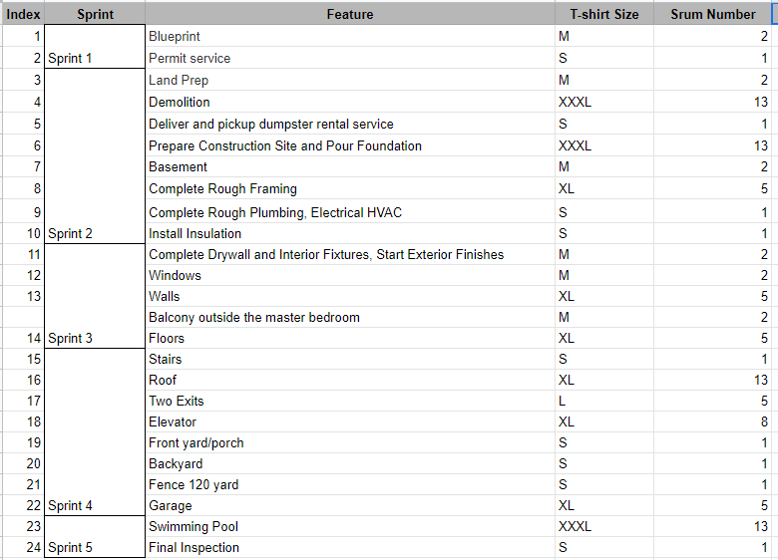
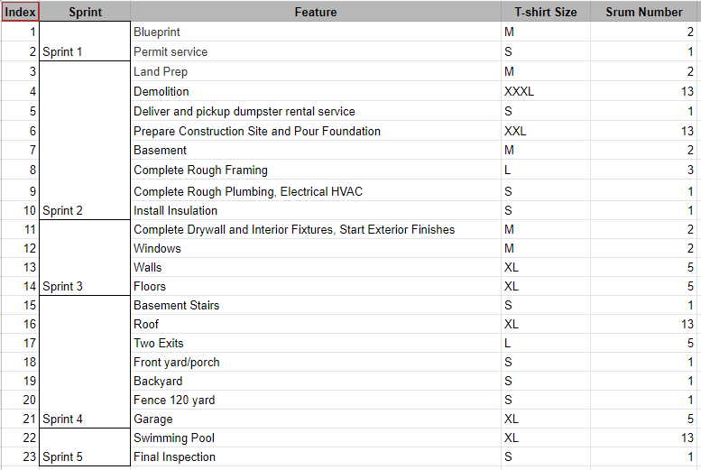
Day 1 Experience
Consisted of...
Meeting with our Project Owner to gather requirements and produce a requirement document with user stories.
1 Story Home Req.
2 Story Home Req.

Slide 7
Day 1 Experience
Pros: Researching Team Etiquette Team Bonding
Cons: Every feature was an EPIC. Planned all of our sprints ahead of time. We didn’t fully understand project requirements yet.

Slide 8
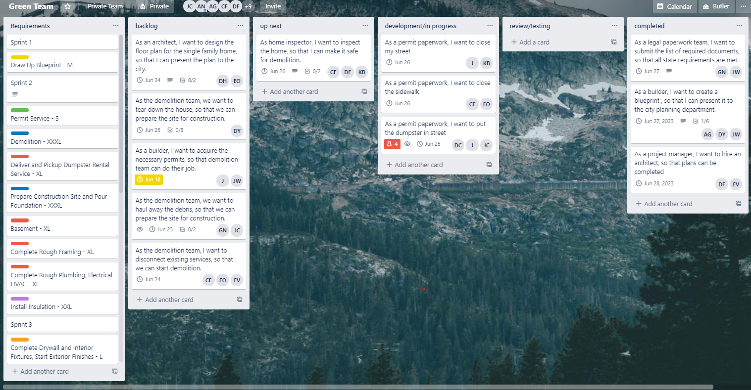
Day 2 Experience
Converting the requirement document to Trello agile form.
Retrospective
What went well- Researching and collaborating to accomplish what our clients required.
Problems- Unclear roles that caused issues with other people's work.
Actions to take- Better collaboration with our group and client.
Progression
Put our requirement document on a Trello board, Implementing an agile methodology .
Converted epics into user stories
Found a technology to help show our client homes.
Results
We created a 3d model for both the single and double story homes.
Unrealistic task were removed and essential tasks were delegated.
Original Trello board
Notes:
What was our task for the day?
: Our task for the day was to convert our requirements into task using the agile methodology.
How we initially went about it?
We put the sprints in as trello cards and made boards similar to how our instructor Leon showed us.
Roles people took on before during our first trello board
Our scrum master assigned roles and there wasn’t much choice in deciding our roles, it was kinda like a practice run (talk to james about this. )
Pro and cons to our original trello board:
Pros:
It's very details with cards that has all the main points for our houses
Cons:
It doesn’t represent our agile methodology very well. There are cards that did not belong to our sprints due to being irrelevant.
After some coaching with leon:
After some clarification we decided to break our user stories into smaller tasks
We decided to make a 3d model of our homes based on how how our tasks in our trello board and after accidentally nuking the first we continued with refineding the process of agile to both our single and 2 story homes.

Slide 9
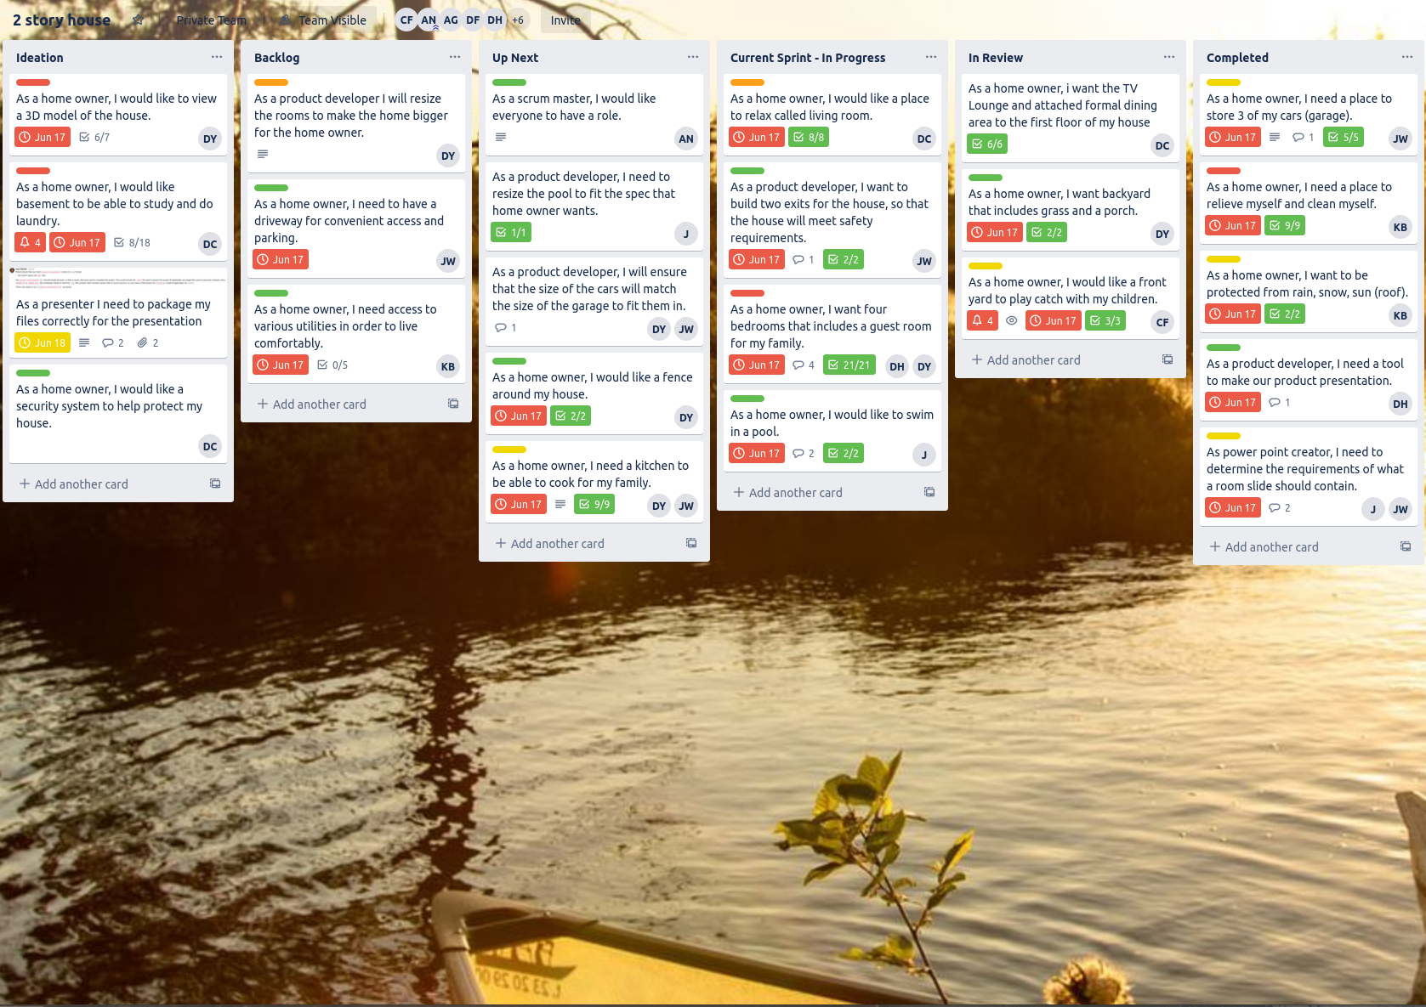
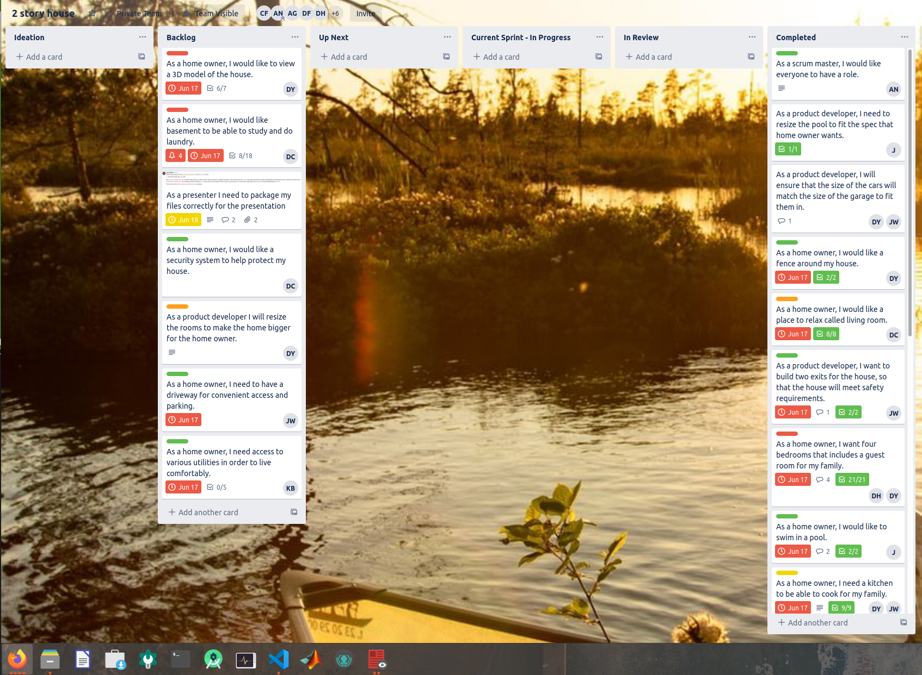
Trello Process
2 Story house finalized with construction
2 Story house in middle of production
Notes:
NEXT DAY EXPERIENCE

Slide 10
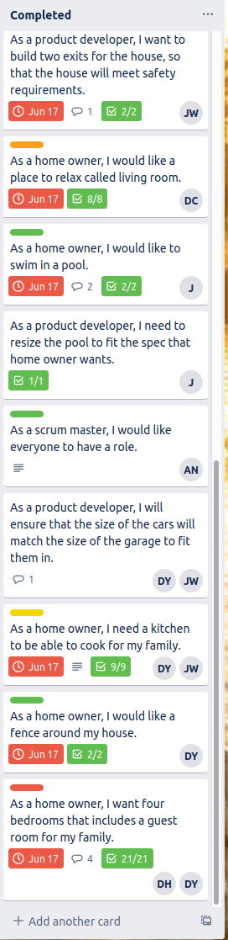
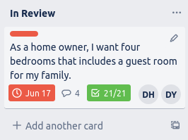
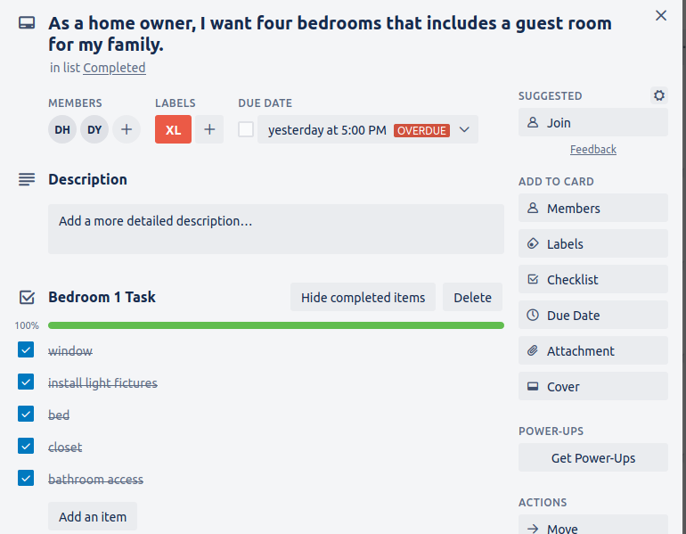
Trello Process Flow
This shows the process of a single user story; the bedroom card.This user story made an extensive journey through the Trello board.
Notes:
NEXT DAY EXPERIENCE

Slide 11
Day 3 Experience
Retrospective
What went well? - The production improved through better collaboration and interaction.
Problems - The lack of team involvement, no opportunity for each developer to voice their concerns.
Action to take - Open conversation, have each voice counted, each developer contributed.
Progression
Each developer provided a brief discussion of what is done, in process and will be completed in the upcoming sprint.
The clear goal set - to implement the backlog items through effective involvement of the whole team.
Split into two teams to enhance the production and narrow the focus: One-Story house in Trello Board and Two-Story house in Trello Board and the graphic 3D design deliverables.
As the team progressed through the sprint the two scrum masters delegated roles, guided and provided support to the developers.
Notes:
THIRD DAY EXPERIENCE

Slide 12
Day 3 Experience
Progression (continued)
Product Owner evaluated the quality of the product deliverables such as the Trello board and 3D design and suggested to start a new board for each.
The product owner clarifies expectations for the final product.
During the current sprint phase, each developer worked closely with the lead developer to ensure the requirement of the product owner and feature assigned to them is present in the design.
New tasks were created after Review and put into Backlog.
The need for more expertise in construction and the use of 5D planner tool emerged.
During the creation process team discovered one room taking 30 minutes and team lead decided take the project room by room.
Resizing of objects occured after the finalization of the frame.
Notes:
THIRD DAY EXPERIENCE

Slide 13
Day 3 Experience
Results
The team planned Sprints ahead of time.
The team had overcome bottlenecks.
The 5D planner tool limitations were discovered and needed immediate attention from the lead developer in order to preserve requested dimensions of the product features.
The developers were able to convert EPICs into user stories.
The Team took advantage of Trello by utilizing its features in the Sprint process.
Notes:
THIRD DAY EXPERIENCE

Slide 14
Day 4 Experience
Retrospective
What went well - Productivity, Communication
Problems - Merging of ideals.
Actions to be taken - Finalize models, complete presentations.
Each developer went over what they accomplished during the previous sprint, what they were planning to work on until the next meeting, and what obstacles were getting in the way of completing their job.
Progression
Had scrum master delegate roles for presentation, like presenter and slide reviewers.
Optimize workflow by having everyone work independently.
Removed bottlenecks in development workflow.
Used Agile methodologies to keep development dynamic and flexible.
Results
Finished both models following the clients specifications.
Used SCRUM to complete presentation to review what we learned.
Notes:
THIRD DAY EXPERIENCE

Slide 15
One-Story Requirements
Interior Design
Smart home
front -yard
4 bedrooms
1 bathroom per each bedroom
1 guest bathroom
Each room has a window?
3 car garage
4 car garage (optional)
Furnished Basement
Living room
Wooden flooring
Tile floor (optional)
Vinyl flooring (optional)
Painted Drywall and Ceiling
White color painting
Each room with closet
Exterior Design
Fencing around 100 yards.
Swimming pool
Backyard
Dark brown roofs
Shingle roof
Light-brown walls
Brick wall
Two exit door
Insulation
Floor insulation (optional)
Insulation with viper in ceiling
Basement entry wall standard
Kitchen
Island kitchen
Wall tiles
Lots of storage
Smart kitchen
Stainless appliances
Walk-in Pantry
Wooden floor
Vinyl flooring (optional)
Baths
Master bath with garden tub
Each room with a bathroom
Dual sink in each bathroom
Tile shower masters bathroom
Utilities
Solar energy
Natural gas
City water
Central heat
Central air
City backup electric grid (optional)
Wifi and Smart home
Security system (optional)
Miscellaneous
Drop down stairs to attic
L shaped stairs to basement
Panel box is dropped to basement area
Notes:
OVERVIEW

Slide 16
Two-Story Requirements
Interior Design
front -yard
4 bedrooms
1 bathroom per room
1 guest bathroom
Each room has a window?
3 car garage
Furnished Basement
Living room
Wooden floor
Tile floor (optional)
Painted Drywall and Ceiling
White color painting
Tv Lounge
Gallery (optional)
Back porch (optional)
Front porch (optional)
Additional bedroom (optional)
Upstairs Loft area (optional)
Exterior Design
Fencing around 90 yards.
Swimming pool
Backyard
Fence(vinyl)
Dark brown roofs
Shingle roof
Light-brown walls
Brick wall
Two exit doors
Balcony (optional
Insulation
Floor insulation (optional)
Insulation with viper in ceiling
Basement entry wall standard
Kitchen
Island kitchen
Wall tiles
Lots of storage
Smart kitchen
Stainless appliances
Walk-in Pantry
Baths
Master bath with garden tub
Each room with a bathroom
Dual sink in each bathroom
Tile shower master bathroom
Utilities
Solar energy
Natural gas
City water
Central heat
Central air
City backup electric grid (optional)
Wifi and Smart home
Security system
Miscellaneous
Drop down stairs to attic
L shaped stairs to basement
Panel at garage
Notes:
OVERVIEW

Slide 17
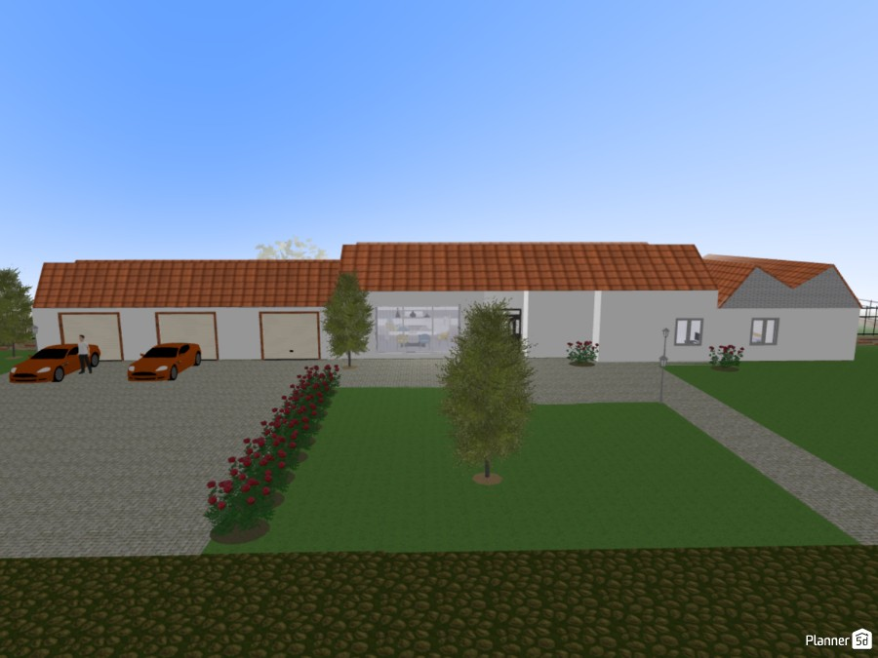
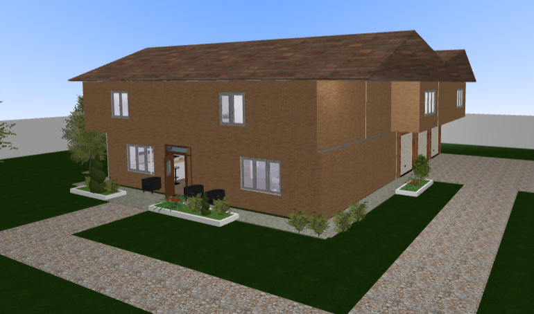
A Tale Of Two Houses
Notes:
OVERVIEW

Slide 18
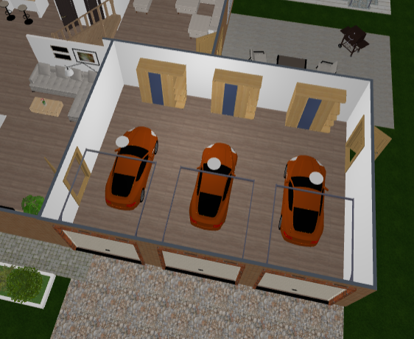
Exemplifying Agile
Building a Garage
Research indicates new, side door required
Collaboration between developer and lead developer
Late-stage resizing of assets
Agile Concepts
Individuals and interactions over processes and tools
Responding to change over following a plan
Welcome changing requirements, even late in development
Build projects around motivated individuals. Give them the environment and support they need, and trust them to get the job done.
The most efficient and effective method of conveying information to and within a development team is face-to-face conversation.
The best architectures, requirements, and designs emerge from self-organizing teams.
Notes:
THIRD DAY EXPERIENCE

Slide 19
Conclusion
Summary of how our productivity shot through the roof throughout the days:
At starting we had issues to figure out how to involve everyone in the tasks but after splitting the team in different groups the productivity got increased.
All team members were involved in the tasks after we assigned the roles for everyone.
We learnt how to assign different features/requirements in different t-shirt sizes, scrum numbers.
We learned to understand the requirements of the client and take notes in an efficient manner.
We learned to use the collaboration tools like Trello to work in Agile environment. We had divided our tasks in different sprints to make sure to work in the iterative environment.
We had the scope of continuous change to make sure we deliver the best to our client.
Notes:
CONCLUSION

Slide 20
Conclusion
2: Team Morale:
The Team Morale went up each and every day when we got the understanding that we together as a one team should focus more on learning the new tasks.
All of us supported each other and we had confident that together as a team our work will be done in a better and proficient way
3: How Bottlenecks were crushed:
The first bottleneck we faced was that as a group of so many people in the virtual environment how to decide when to speak and when not to speak which was eventually fixed once we got to know each other better and starting the retrospective and stand ups where everyone got the chance to speak.
The second bottleneck was how to make sure that everyone is involved in some or the other task which got better by assigning roles to each and every team member after dividing all the members into different groups.

Slide 21
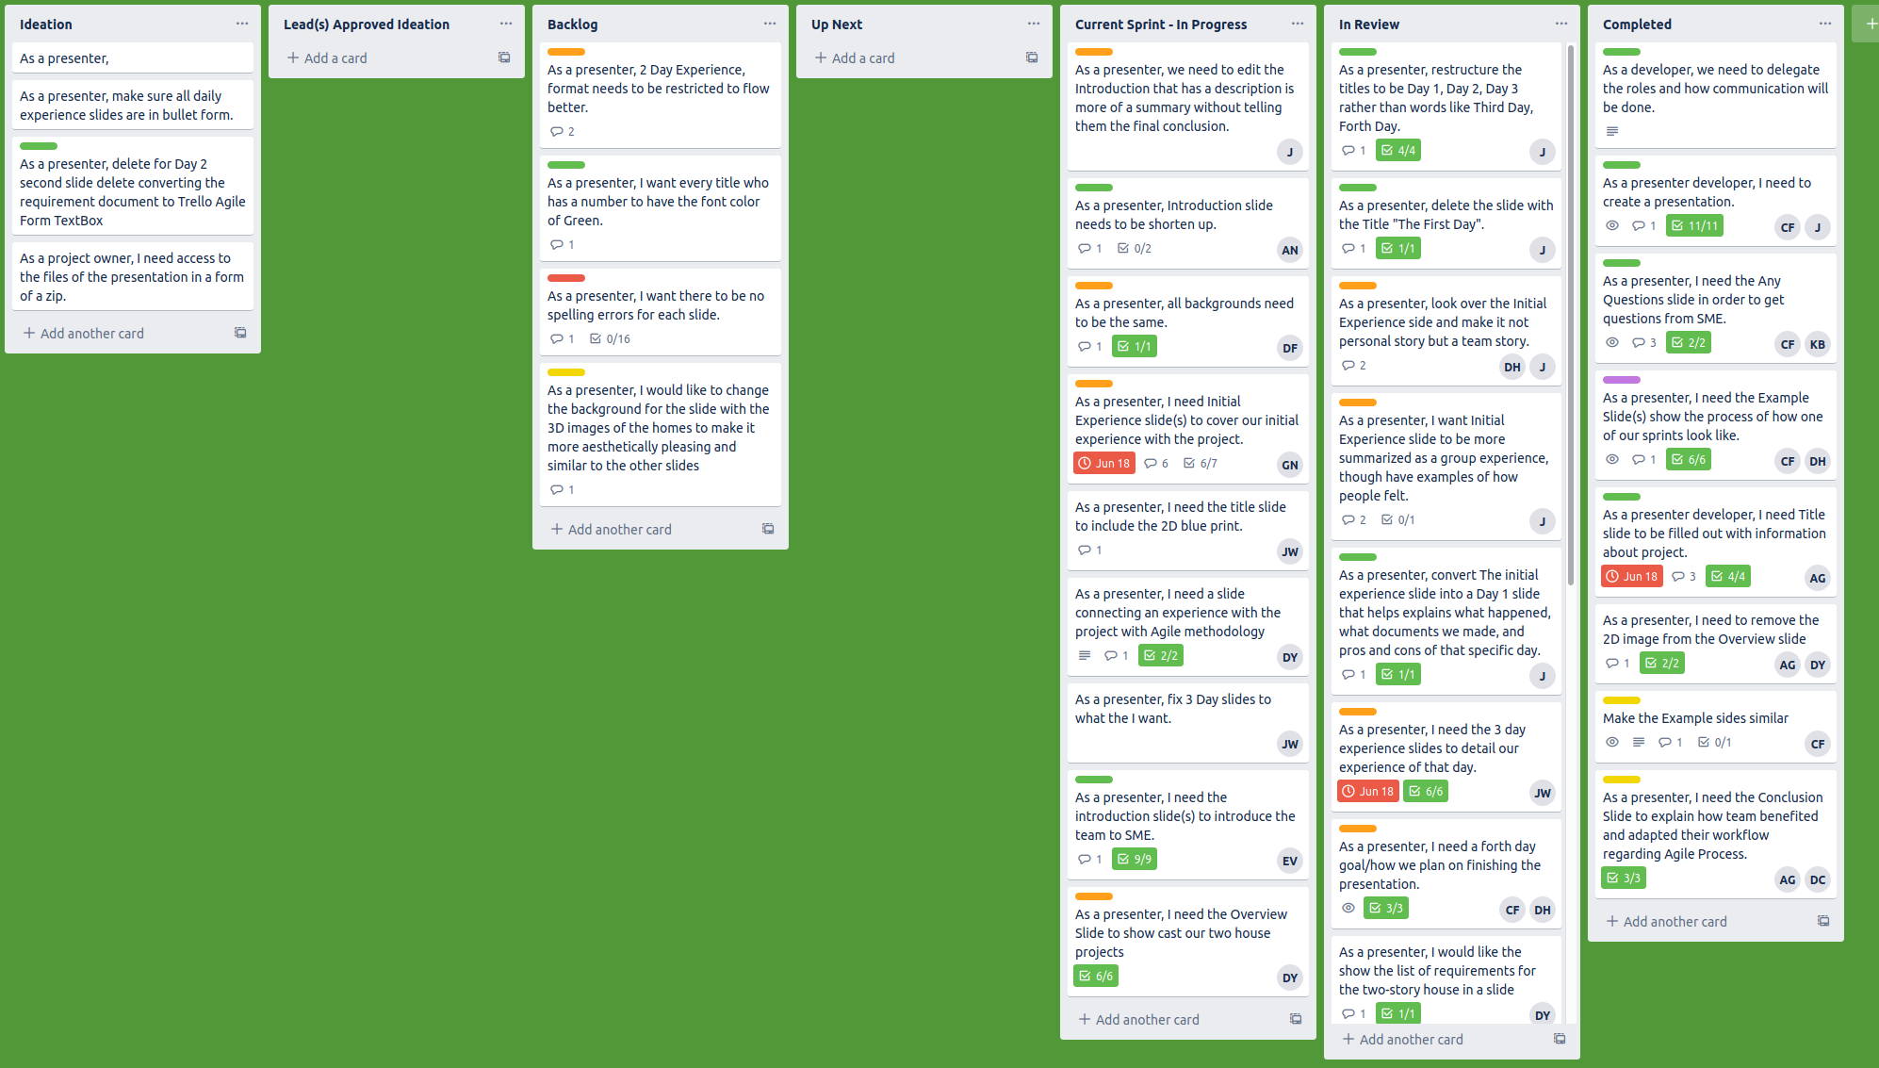
Applying what we learned

Slide 22
Please limit the time of your questions to 5 minutes to be considerate to the other team.
THANK YOU FOR WATCHING!
Any Questions?
Notes:
ANY QUESTIONS

